Slide 1
Agenda
Jenkins
What is Jenkins?
Jenkins Features
Jenkins Architecture
Jenkins Pipeline

Slide 2
Jenkins Overview

Slide 3

Introduction to Jenkins
Jenkins is one of the most famous Java-based open-source tool.
A software that allows continuous integration.
Allows code to be developed and tested almost immediately.
Removes a lot of burden for the testers and provides quicker integration
Also known as the Heart of the DevOps pipeline.

Slide 4
Jenkins Setup

Slide 5
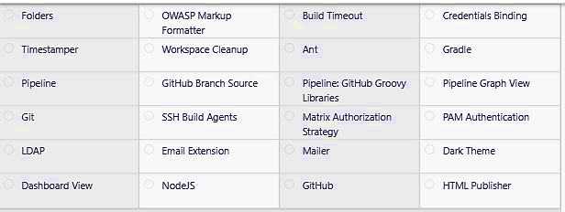
Jenkins Setup

Slide 6
Jenkins Workflow

Slide 7
Jenkins Workflow
Developers check their source code.
Jenkins will pick up the changed source code and trigger a build and run any tests if required.
The build output will be available in the Jenkins dashboards. Automatic notifications can also be sent back to the developer.

Slide 8
Advantages of Jenkins
Platform Independent
Open-Source
Free of cost
In-built Plugin
Community Support
Hosting
Continuous Integration

Slide 9
Before and After Jenkins
Before Jenkins | After Jenkins
The entire source code was built and then tested. Locating and fixing bugs in the event of build and test failure was difficult and time-consuming, which in turn slows the software delivery process. | Every commit made in the source code is built and tested. So, instead of checking the entire source code developers only need to focus on a particular commit. This leads to frequent new software releases.
Developers have to wait for test results. | Developers know the test result of every commit made in the source code on the run.
The whole process is manual. | You only need to commit changes to the source code and Jenkins will automate the rest of the process for you.

Slide 10
Jenkins Architecture

Slide 11
Jenkins Architecture
Jenkins follows Master-Slave architecture to manage distributed builds.
In this architecture, slave and master communicate through TCP/IP protocol.
Jenkins architecture has two components:
  Jenkins Master/Server
  Jenkins Slave/ Node/ build Server

Slide 12
Jenkins Master
Main server of Jenkins is the Jenkins Master.
A web dashboard which is nothing but powered from a war file.
By default it runs on 8080 port.
With the help of Dashboard, we can configure the projects but the build takes place in Nodes.
By default one node (slave) is configured and running in Jenkins server.
We can add more nodes using IP address, user name and password using the ssh, jnlp or webstart methods.

Slide 13
Jenkins Master
The server's job or master's job is to handle:
  Scheduling build jobs.
  Dispatching build to the nodes/ slaves for the actual execution.
  Monitor the nodes/slaves (possibly taking them online and offline s required).
  Recording and presenting the build results.
  A Master/ Server instance of Jenkins can also execute build jobs directly.

Slide 14
Jenkins Slave
Used to execute the build jobs dispatched by the master.
We can configure a project to always run on a particular slave machine, or simple let the Jenkins to pick the next available slave/node.
Jenkins Master/Servers and Slave/nodes can be configured in any servers including Linux, Windows, and Mac.

Slide 15
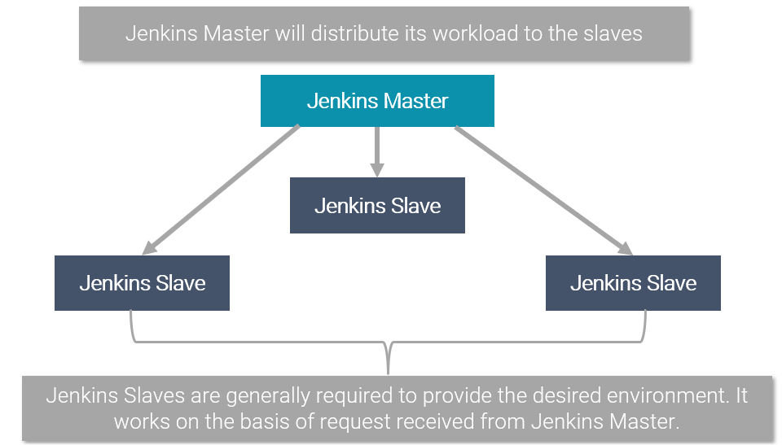
Jenkins Slave

Slide 16
Jenkins Pipeline

Slide 17
Jenkins Pipeline
Jenkins pipeline is a collection of codes written in a Jenkins file.
Allows the Jenkins to operate in a sequence.
Provides a platform to run each job simultaneously.
Pipeline enables the workflow of the jobs by using the pipeline plug-in.

Slide 18
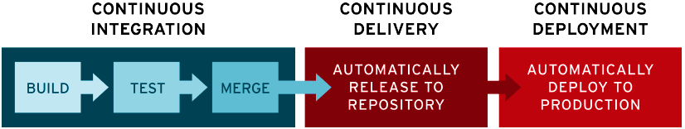
Jenkins CI/CD Flow

